Slide 1
The Aztecs
Ancient Civilization of the Americas

Slide 2
Introduction to the Aztecs
The Aztecs were an ancient civilization that thrived in Mesoamerica from the 14th to the 16th century.
They built an empire and established their capital city, Tenochtitlan, on an island in the middle of Lake Texcoco (now Mexico City).
The Aztecs were known for their advanced agricultural practices, remarkable architecture, and intricate social and religious systems.

Slide 3
Origins of the Aztecs
The Aztecs originated from northern Mexico, migrating to the central plains of Mexico in the 12th century.
According to their mythology, they were guided to their new homeland by their god Huitzilopochtli.
The Aztecs gradually established alliances and became a dominant force in the region.

Slide 4
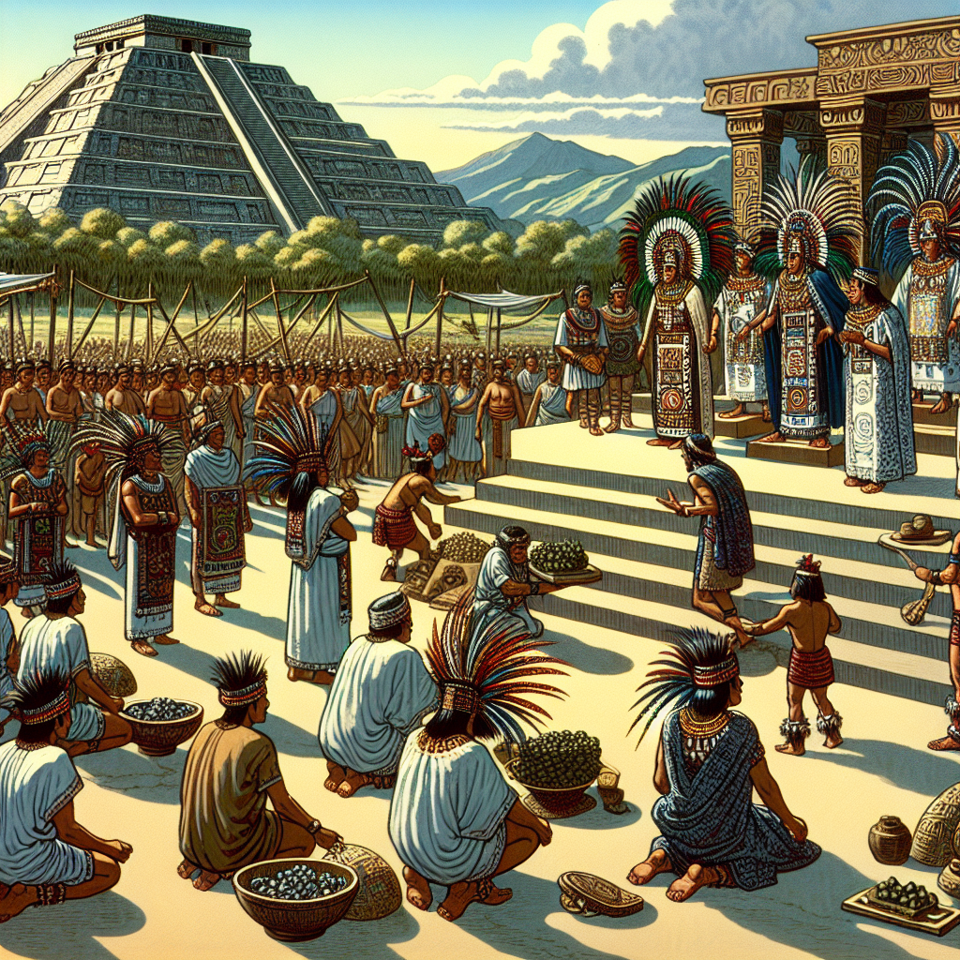
Aztec Society and Hierarchy
Aztec society was highly structured, with a hierarchical system.
At the top of the social hierarchy were the nobility, including the ruler, priests, and warriors.
Below them were the commoners, who were engaged in various occupations such as farming, crafts, and trade.
Aztec Social Hierarchy

Slide 5
Religion and Cosmology
Religion played a central role in Aztec society.
They worshipped a pantheon of gods and goddesses, with Huitzilopochtli being one of the most important deities.
The Aztecs believed in the cyclical nature of the universe and performed elaborate rituals and sacrifices to appease their gods.

Slide 6
Aztec Achievements
The Aztecs made significant advancements in various fields.
They developed an advanced agricultural system known as chinampas, which involved floating gardens for cultivation.
The Aztecs also had impressive architectural structures, such as temples and pyramids, and excelled in arts and crafts.

Slide 7
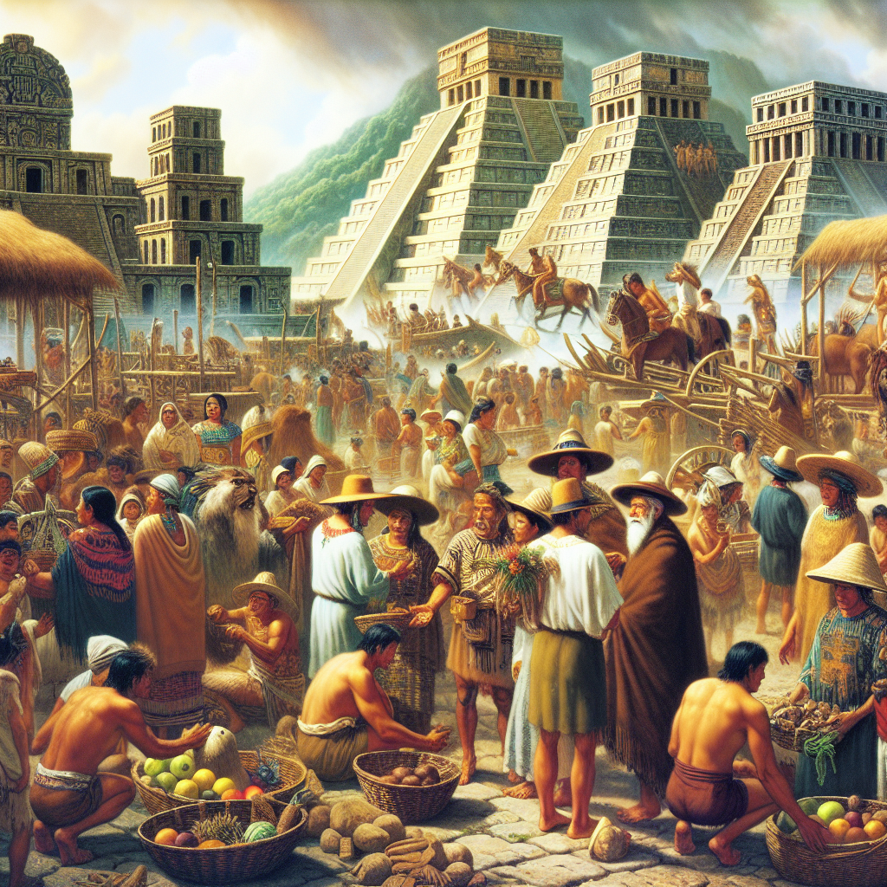
Contact with the Spanish
The arrival of Spanish conquistadors, led by Hernan Cortes, in 1519 marked the beginning of the end for the Aztec empire.
The Aztecs initially saw the Spanish as gods, but conflicts arose, leading to the downfall of their empire.
The Spanish ultimately conquered Tenochtitlan in 1521, ending Aztec dominance in the region.
Spanish Conquest of the Aztecs

Slide 8
Legacy of the Aztecs
Despite the downfall of their empire, the Aztecs left behind a lasting legacy.
Their cultural and artistic contributions continue to inspire and influence modern-day Mexico.
The Aztec language, Nahuatl, is still spoken by indigenous communities in Mexico.

Slide 9
Conclusion
The Aztecs were a fascinating civilization that achieved remarkable advancements in various areas.
Their society, religion, and achievements continue to captivate and intrigue people today.
Studying the Aztecs allows us to gain insights into the rich cultural heritage of Mesoamerica.

Slide 10
References
1. Townsend, R. F. (2009). The Aztecs. Thames & Hudson.
2. Smith, M. E. (2012). The Aztecs (3rd ed.). Wiley-Blackwell.
3. Carrasco, D., & Sessions, S. (2007). Daily Life of the Aztecs. Greenwood Press.

Slide 11
Thank You
Thank you for your attention!
Any questions?

